Slide 1
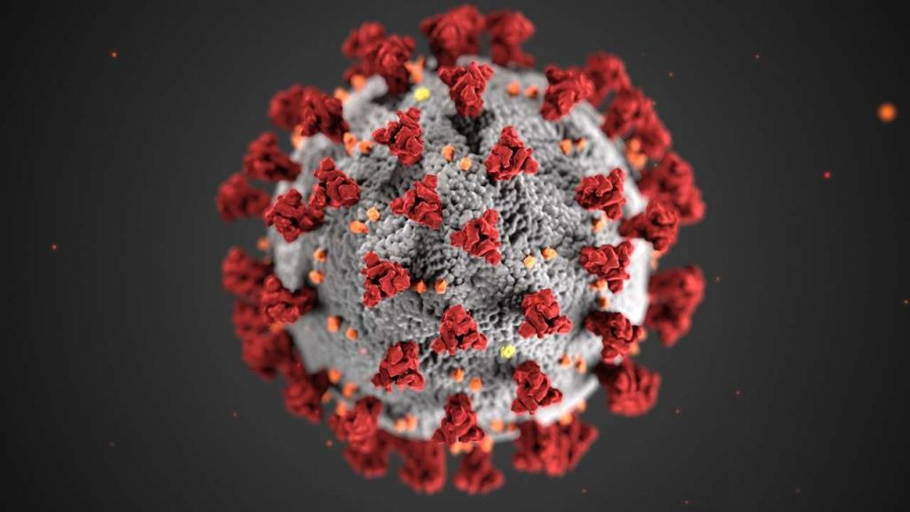

Covid-19 Vaccination

Slide 2

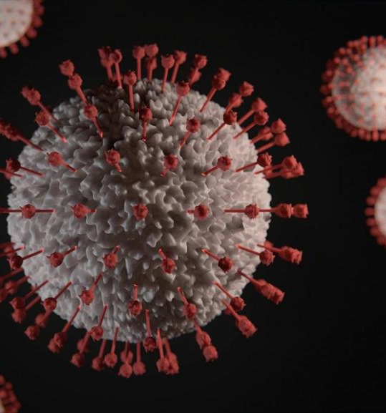

What is Covid-19?
Coronavirus disease (COVID-19) is an infectious disease caused by a newly discovered coronavirus.
Most people infected with the COVID-19 virus will experience mild to moderate respiratory illness and recover without requiring special treatment. Older people, and those with underlying medical problems like cardiovascular disease, diabetes, chronic respiratory disease, and cancer are more likely to develop serious illness.

Slide 3

How does Covid-19 spread?
The COVID-19 virus spreads primarily through droplets of saliva or discharge from the nose when an infected person coughs or sneezes, so it’s important that you also practice respiratory etiquette (for example, by coughing into a flexed elbow).

Slide 4

How to slow down Covid-19?
The best way to prevent and slow down transmission is to be well informed about the COVID-19 virus, the disease it causes and how it spreads. Protect yourself and others from infection by washing your hands or using an alcohol based rub (sanitizer) frequently and not touching your face.

Slide 5
Prepare for Your COVID-19 Vaccination:
Take Vaccination only if you are healthy and medically fit. If you were not well or have suffered from any illness, fever, cold and cough. Please wait one month before taking the Vaccination or consult a doctor before taking the COVID 19 Vaccine
Do not take counter medicine – such as ibuprofen, aspirin, or acetaminophen – before vaccination to prevent vaccine-related side effects..
If you’ve ever experienced a severe allergic reaction from any vaccine or you have any questions about the medications you are currently taking, talk to your health care provider before your appointment.
Get a good rest and stay hydrated and eat healthy diet before your vaccination so you do not feel any Dizziness or light headed.
People who were infected with the virus or are receiving COVID treatment in the form of blood plasma therapy or monoclonal antibodies, then they must refrain from taking the vaccine.

Slide 6

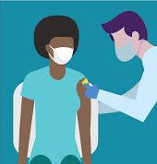
Guideline For Vaccination:
The Centre Government has issued guidelines on the “effective implementation of the New Vaccination Strategy”
According to the new guideline all adults (above 18 year) will become eligible for a Covid-19 vaccine From 1st May 2021.
The vaccines are being administered free of cost at government hospitals and health centres.

Slide 7

Steps to register for Vaccine
The people of the state can register and book an appointment for vaccination, anytime and anywhere, using the Co-WIN 2.0 portal or through other IT applications such as Aarogya Setu.
Vaccine registration for all above 18 years will start from 28 April on the Co-Win platform and the Aarogya Setu app.
Please carry a Government ID while going for vaccination.

Slide 8
Timing of your second shot:
The timing between your first and second shots is 4 week (28 days).
If you received the Covishield COVID-19 Vaccine and CovaxinCOVID-19 Vaccine, you should get your second shot 4 weeks (or 28 days) after your first Shot
You should get your second shot as close to the recommended 4-week interval as possible. However, your second dose may be given up to 6 weeks (42 days) after the first dose, if necessary. You should not get the second dose early. ​There is currently limited information on the effectiveness of receiving your second shot earlier than recommended or later than 6 weeks after the first shot.

Slide 9

The Vaccination Process: What To Expect
The vaccination site will have three rooms:
Waiting room: Where one will wait before you get the vaccine
Vaccination room: A place where you will be given the vaccine
Observation room: An area where you will be observed for 30 minutes post receiving the vaccine
A five-member vaccination team will be entrusted with the process:
Vaccination officer 1: For pre-checking the registration
Vaccination officer 2: For authentication
Vaccination officer 3: In-charge of giving vaccine. Since it is an intramuscular vaccine, a trained professional will administer the vaccine
Vaccination officer 4 and 5: In-charge of crowd management and 30-minute observation

Slide 10
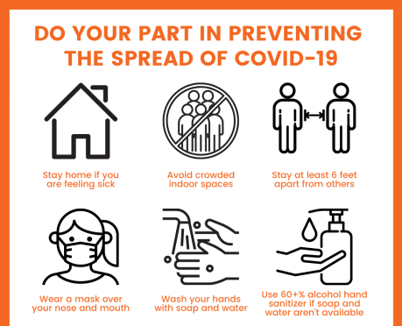
When you are fully vaccinated?
Safe and effective vaccines will be a game changer: but for the foreseeable future we must continue wearing masks, physically distancing and avoiding crowds. Being vaccinated does not mean that we can throw caution to the wind and put ourselves and others at risk, particularly because it is still not clear the degree to which the vaccines can protect not only against disease but also against infection and transmission.

Slide 11
Thank You
#GetTheBestOutofUs

